Slide 1
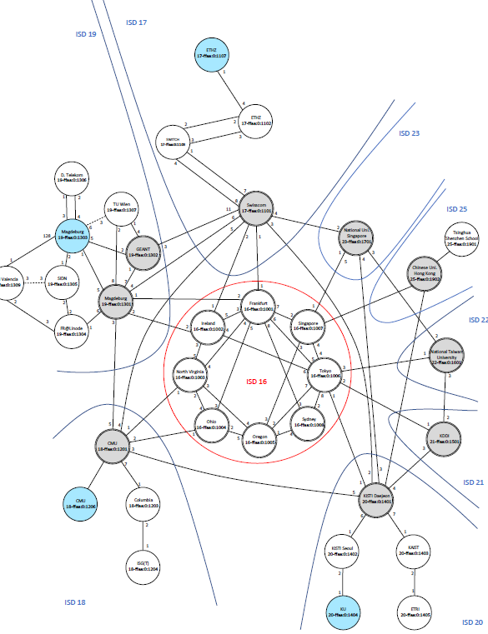
SCION: Heir to the throne♕
A next-generation MOBA

Slide 2

MOBA: Multiplayer Online Battle Arena
Play on the real SCIONLab network
Control endpoints on this topology
Create a sender application to transfer data

Slide 3
Aim of the Game
Create an application that delivers as much data as possible over the network.
The application will run on a source server…
… and will send data to pre-defined sink server
Later who selects sources, sinks etc…

Slide 4

“How to play”
SCIONLab Network
Players
Notes:
So far it is pretty clear that there is you, the players, and a network. But how will you be able to run code on remote servers? How will you receive your scores? How will you check if your code did what you wanted it to do?

Slide 5



“How to play”
Source and Sink Servers
SCIONLab Network
Players
Notes:
So far it is pretty clear that there is you, the players, and a network. But how will you be able to run code on remote servers? How will you receive your scores? How will you check if your code did what you wanted it to do?

Slide 6

“How to play”
Source and Sink Servers
SCIONLab Network
Web Server
Players
Notes:
So far it is pretty clear that there is you, the players, and a network. But how will you be able to run code on remote servers? How will you receive your scores? How will you check if your code did what you wanted it to do?

Slide 7

“How to play”
Source and Sink Servers
SCIONLab Network
Web Server
Players
Notes:
So far it is pretty clear that there is you, the players, and a network. But how will you be able to run code on remote servers? How will you receive your scores? How will you check if your code did what you wanted it to do?

Slide 8

“How to play”
Source and Sink Servers
SCIONLab Network
Web Server
Players
Notes:
So far it is pretty clear that there is you, the players, and a network. But how will you be able to run code on remote servers? How will you receive your scores? How will you check if your code did what you wanted it to do?

Slide 9

“How to play”
Source and Sink Servers
SCIONLab Network
Web Server
Players
Notes:
So far it is pretty clear that there is you, the players, and a network. But how will you be able to run code on remote servers? How will you receive your scores? How will you check if your code did what you wanted it to do?

Slide 10
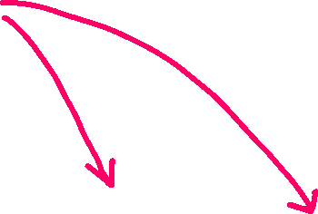
“How to play”
Source and Sink Servers
SCIONLab Network
Web Server
Players
Notes:
So far it is pretty clear that there is you, the players, and a network. But how will you be able to run code on remote servers? How will you receive your scores? How will you check if your code did what you wanted it to do?

Slide 11
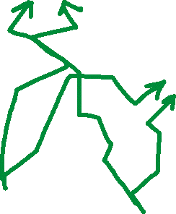
“How to play”
Source and Sink Servers
SCIONLab Network
Web Server
Players
Notes:
So far it is pretty clear that there is you, the players, and a network. But how will you be able to run code on remote servers? How will you receive your scores? How will you check if your code did what you wanted it to do?

Slide 12
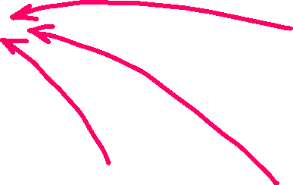

“How to play”
Source and Sink Servers
SCIONLab Network
Web Server
Players
Notes:
So far it is pretty clear that there is you, the players, and a network. But how will you be able to run code on remote servers? How will you receive your scores? How will you check if your code did what you wanted it to do?

Slide 13
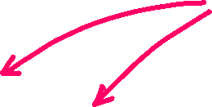
“How to play”
Source and Sink Servers
SCIONLab Network
Web Server
Players
Notes:
So far it is pretty clear that there is you, the players, and a network. But how will you be able to run code on remote servers? How will you receive your scores? How will you check if your code did what you wanted it to do?

Slide 14


“How to play”
Source and Sink Servers
SCIONLab Network
Web Server
Players
Grafana + InfluxDB
Notes:
So far it is pretty clear that there is you, the players, and a network. But how will you be able to run code on remote servers? How will you receive your scores? How will you check if your code did what you wanted it to do?

Slide 15
Game Rounds
The game happens in rounds, one every 90 seconds
In every round, the latest version is run from the source for 30 seconds
At the end of the round, the number of transferred bytes is collected and the score is computed
1 source and 3 sinks are computed randomly at each round
5 rounds are for “testing”, 5 rounds count towards the final score!

Slide 16

Your Score: $$min\left\{\frac{\#Bytes_transferred}{\#Bytes_goal}, 1\right\}$$

Slide 17
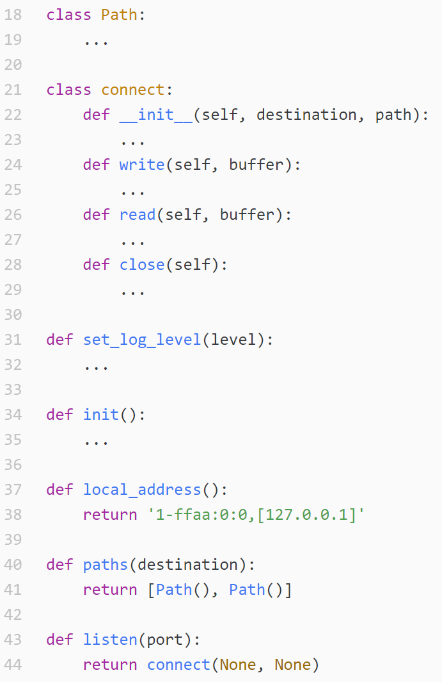





The SCION Python API
Representation of SCION paths
Socket-type connection
Initialization of the API
Getting paths to the destination
Listening

Slide 18
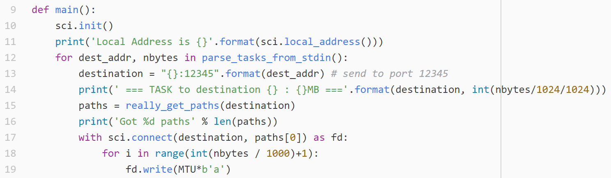
Example code 1

Slide 19
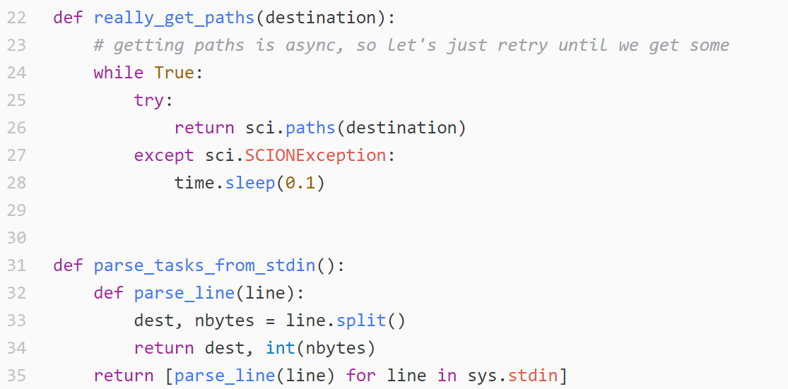
Example code 2

Slide 20
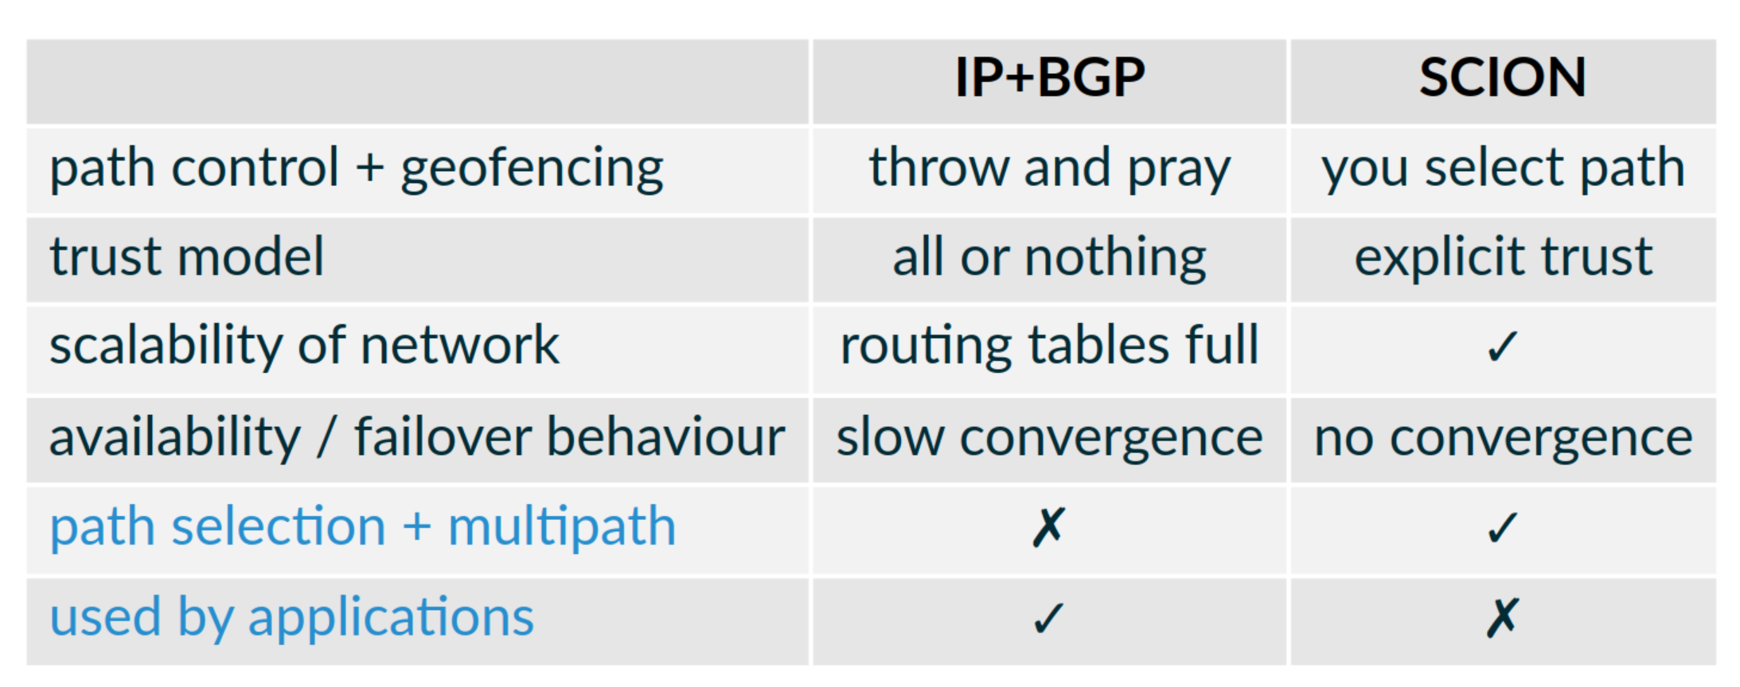
Getting creative!
Use multiple paths to the same destination
Multithreading
DoS the paths of your adversaries
… you name it!

Slide 21
Scores & prizes
At the end of the game, the scores in the 5-minute, non-test rounds are summed up
Team with the highest score is the winner!
Amazing prizes for the first 3 classified teams!

Slide 22
Signing up, submitting, getting the logs
https://github.com/netsec-ethz/scionlab-workshop/tree/master/example
All the functionality is in scionlab.sh
Use as a command line tool to:
REMEMBER TO $ export TEAM_TOKEN=<token>
Signup your team | ./scionlab.sh signup TEAMNAME
Signup your team | ./scionlab.sh signup TEAMNAME
Submit new code | ./scionlab.sh submit FILENAME
Signup your team | ./scionlab.sh signup TEAMNAME
Submit new code | ./scionlab.sh submit FILENAME
Get the latest logs | ./scionlab.sh log

Slide 23


Slide 24
“How to play”
Source and Sink Servers
SCIONLab Network
Web Server
Players
Grafana + InfluxDB
Notes:
So far it is pretty clear that there is you, the players, and a network. But how will you be able to run code on remote servers? How will you receive your scores? How will you check if your code did what you wanted it to do?

